Slide 1

UNIVERSITY OF MAKENI SYLVANUS KOROMA CAMPUS YONI
TEXT-BASED ADVENTURE GAME
BY:
ISATU MAGDALENE KAMARA 4341
EMMANUEL F. BANGURA 2894
Summitted to: Mr. Ibrahim Kalokoh
Date: 10th April, 2021

Slide 2
ABSTRACT
This is a python-based project for a simple version of an old-fashioned text-based adventure game.
The is an electronic game type that uses text-based user interface, that is, the user interface employs a set of encoded characters instead of vector graphics.
The game gives players a description of what’s happening, and then asks them to make a choice.
Something happens depending on choice the player made.
The game also includes some random factors, so that it’s a little different from each time.
The game has conditions for winning and losing.

Slide 3
OUTLINE
Introduction/Motivation
Implementation
Results
Conclusion
References

Slide 4
INTRODUCTION/MOTIVATION
The purpose of this section is to give an introduction of the text-based adventure game project and a motivation to why it is useful.
Today many games can present close to photo-realistic graphics
But the step between good and bad graphics are getting smaller and smaller
To create a useful game you need something more fascinating and interesting story.
Unfortunately, not many people competent enough to write interesting stories in the gaming industry.
Therefore, in this project, we firstly created a beautiful story for this adventure game and turn the story into a game by using python programming language

Slide 5
DESCRIPTION OF THE HOW THE TEXT-BASED ADVENTURE GAME WORKS
The story of the game revolves around adventure.
The players takes the role of an unnamed adventurer who is trapped in an unknown location. For our case, “thick dark forest”.
To progress, players type in various contextual commands in reaction to the story that is written out for them.
Players will encounter multiple items and enemies throughout their quest to escape.
it is up to the player's own intuition to use custom typed commands to escape the dangers. For our case, the danger is a fictional humanoid monster called “orc”.

Slide 6
IMPLEMENTATION
This section explains the languages/tools used, a flow chart that show how data flows throughout the program and finally and explanation of code snippets.
Languages/tools used
1. Python
2. Jupyter Notebook (Anaconda 3)
3. Visual Code Editor
4. Git

Slide 7
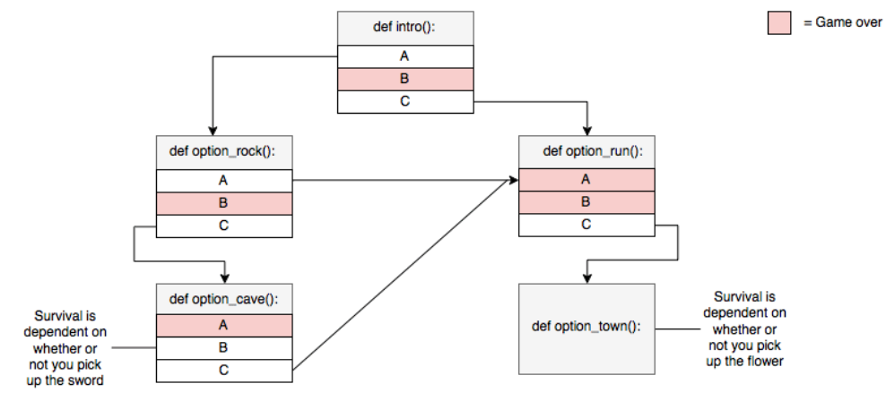
FLOW CHART

Slide 8
HOW THE CODE WORKS
We used predefined python modules like (time), functions and control statements such as if, elif, and else statements. The code makes the text-based game dynamic.
Functions are called based on the answers a player choses.
If a particular answer is given, the player will be branched to a separate section based on the control statements. Now, our code only scratches the surface of few branching.

Slide 9
RESULTS
The result of this project a functional executable text-based adventure game written in python programming language.
To execute the project, one has to make sure Python is installed in the Computer and used any of the available python text editors.
For our case, we used Jupyter Notebook as the environment to run the code.

Slide 10
REFERENCES
Greg Costikyan, Where Stories End and Games Begin, Game Developer Magazine, September 2000, pages 44-53.
Mark DeLoura, Telling Stories, February 2001, Game Developer M
agazine, February 2001, page 4.
https://thecodingpie.com/post/make-your-own-text-based-adventure-game-in-python3
https://screenrant.com/zork-text-adventure-game-call-duty-easter-egg/

